Slide 1


Fintech and banking: What do we know?
Anjan V. Thakor
Journal of Financial Intermediation, 2020

Slide 2
What is FinTech?
WSU
Why?
“What do these developments (FinTech) portend for the future of banking, financial markets, and payments systems?”
“The purpose of this paper is to review the existing literature and synthesize the insights it provides on this question.”
- Thakor
Ultimately, Thakor focuses on the potential advantages/synergies of FinTech, targeting financial intermediation specifically.
“Thus, one promise of fintech is the unveiling of cheaper ways to overcome financial contracting frictions and lower the cost of financial services to improve consumer welfare.”
Fuster et al. (2019) provide evidence that FinTech has improved the “productivity” of mortgage lending. Does this promote risk, moral hazard, etc.?

Slide 3
The Unit Cost
WSU
Why?
Philippon (2014) estimates that the unit cost of financial intermediation in the US has remained at about 2% over the past 130 years.
Philippon (2019) reiterates its 2014 predecessor, citing that “the unit cost of financial intermediation has fallen since the Great Financial Crisis, concluding that FinTech has made the financial sector more efficient.”
This paper (Philippon, 2019) ultimately develops a simple model of “robo-advising,” showing that FinTech’s net effect on welfare crucially depends on the type and size of fixed costs.
Even with an overall increase in participation, various income groups may be affected differently.
This prompts a trend of study that asks if FinTech will increase access to financial services for previously unbanked or under-banked individuals… or, will it increase inequality by favoring some groups more than others?
Are there endogeneity concerns with this? Timely decreases in financial intermediation costs and tech rises… was this intentional, or just circumstantial?

Slide 4
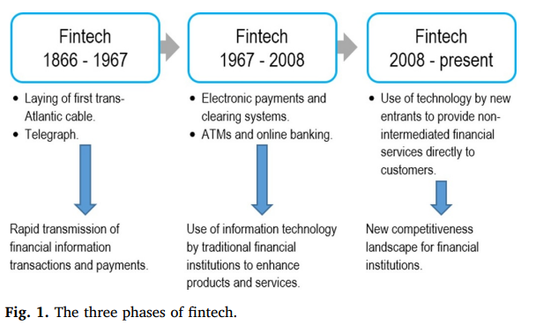
Phases of FinTech?
WSU
Why?
The Financial Stability Board (FSB) defines fintech as “technologically enabled financial innovation that could result in new business models, applications, processes, or products with an associated material effect on financial markets and institutions, and the provision of financial services.”
Helpful?
The tech was always there, just different use cases.

Slide 5
Key Questions
WSU
A New Paradigm
Question 1: How should we modify our theories of financial intermediation so as to accommodate banks, shadow banks, and non-intermediated solutions?
Question 2: How will credit, deposits and capital raising be affected by fintech? Will P2P platforms replace bank lending?
Question 3: On payments, clearing and settlement, what will be the role of cryptocurrencies vis-à-vis fiat money and private money creation by banks? How will this affect central banks?
Question 4: How will Blockchain-technology-assisted smart contracts transform the financial market, including investment management and insurance?

Slide 6
Some Stylized Facts
WSU
A New Paradigm
Stylized Fact 1: Investments in FinTech companies are higher in more financially-developed countries.
Stylized Fact 2: Use of electronic payments is higher in countries where a higher fraction of the population holds an account with a financial institution.
Stylized Fact 3: Investments in FinTech companies are higher in countries with less competitive (more concentrated) banking systems.
Stylized Fact 4: Investments in FinTech companies are higher in countries with higher lending interest rates and lower deposit interest rates.
Investments in FinTech necessitate opportunity and substantial payback (regulatory framework)
Of course, this may lead to endogeneity concerns (e.g., wealthier nation have higher lending rates/better infrastructure)

Slide 7
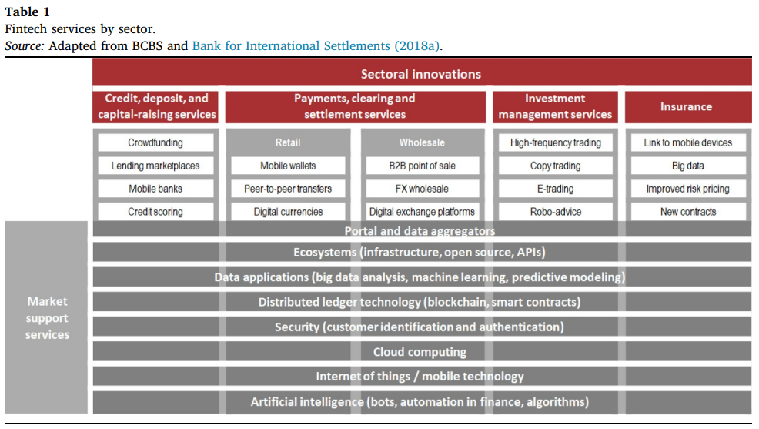
Some Stylized Facts
WSU
A New Paradigm

Slide 8
Growth Opportunities
WSU
A New Paradigm
“Much of the growth in P2P lending has occurred in the aftermath of the 2007-2009 financial crisis (Satoshi Nakamoto, 2012)… Aggregate P2P lending volume is still very small compared with bank lending, but is growing rapidly.”
A recent literature highlights several mechanisms by which ‘Big Tech’ may be able to serve borrowers’ short-term liquidity (Liu et al., 2022):
This has not been shown to impact long-term financing needs
These services include trust, convenience, improved UI, and better monitoring
This is unique to tech firms, but it is still underpinned by traditional banking networks (e.g., MyBank, Venmo, etc.)
This leads to another branch of future research – that is, how FinTech has legitimately changed personal and commercial financing vs. how it has rebranded historical banking structures.

Slide 9
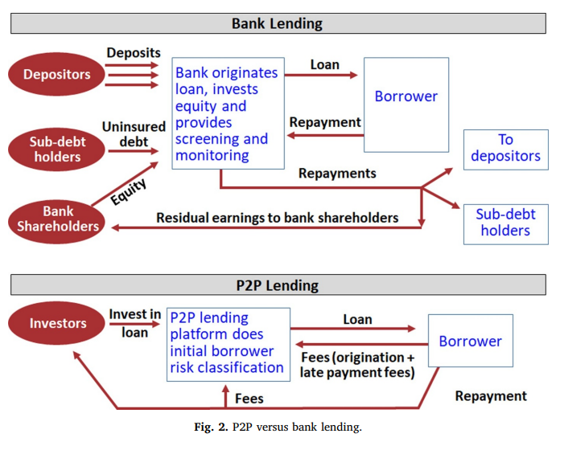
Some Stylized Facts
WSU
A New Paradigm
The P2P Lending Process:
Borrower submits an application for a loan
The platform assigns a ‘loan grade’
Investors then bid on the listing
This is a ‘non-intermediated’ financing
The P2P’s compensation comes from loan origination fees, late fees, and % of payments

Slide 10
Shadow Banks et al.
WSU
Question 1
How do we modify financial intermediation theories to accommodate banks, shadow banks, and non-intermediated solutions?
Thakor believes it beneficial to make a theoretical push in two directions (move past bootstrapping)
Develop an integrated theory of financial intermediation that reflects both the economic functions of financial intermediaries embedded in existing theories, and captures what FinTech firms do, and…
Once such a theory is in hand, begin to rethink our theories of financial system architecture to include banks, markets, and FinTech firms
Let’s focus on P2P lending, how big are the cost differences between banks and P2P platforms – the ones that result from incentive conflicts we expect to see in P2P?

Slide 11
A LendingClub Example
WSU
Question 1
Because P2P provides investors a loan risk classification based on pre-lending screening, there is an incentive problem of inadequate screening – the platform has no skin in the game, so to speak.
“If the company is willing to sell mislabeled goods to one of the largest and most sophisticated clients, why should Joe investor assume he’ll be treated any better. Small investors need to be sure they are receiving the loans they signed up for.”
Thakor and Merton (2019) developed a theory of bank and non-bank lending in which banks have an endogenous advantage over non-bank lenders (including P2P) when it comes to being trusted to make good loans.
Even with incentive problems in banks likely being more numerous and complex than with P2P, banks possess an advantage in developing investor trust due to their access to low-cost deposit funding.
Begley and Srinivasan (2019) provide empirical evidence that supports this.
Origination Fees
Borrowers’ Repayment

Slide 12
Credit & Deposits
WSU
Question 2
Impact of FinTech on credit, deposits, and capital raising: will P2P lending replace bank lending?
“Big data is likely to reduce the impact of negative prejudice in the credit market, but it could reduce the effectiveness of existing policies aimed at protecting minorities.”
- Philippon (2019)
A Blog
Community Reinvestment Act
Reducing bias in AI-based financial services
Retail
Thakor (2020); Thakor & Merton (2019); de Roure et al. (2019); Philippon (2014, 2019); etc.
Commercial
AFA (2023); Cornelli et al. (2022); Beaumont et al. (2022); Liu et al. (2022)

Slide 13
The Model
WSU
Question 2
“The model (de Roure et al., 2019) generates three main predictions”
If only some banks are subject to an exogenous increase in regulatory costs, and the unaffected banks are not financially strong enough to replace the reduction in credit supply from the affected banks, then banks in the aggregate will lost market share to P2P lenders.
P2P platforms make riskier loans than banks make.
The risk-adjusted interest rates on bank loans are lower than on P2P loans.
This last point is counterintuitive to a prior thought – risk-adjusted rates are higher on P2P loans. To what extent is FinTech (P2P specifically) reducing the cost of financial intermediation, however negligible because of the increased costs of doing business. Ergo, is there a trade-off between efficiency and capital hoarding?
Measuring the welfare cost of asymmetric information in consumer credit markets
Open banking: Credit market competition when borrowers own the data

Slide 14
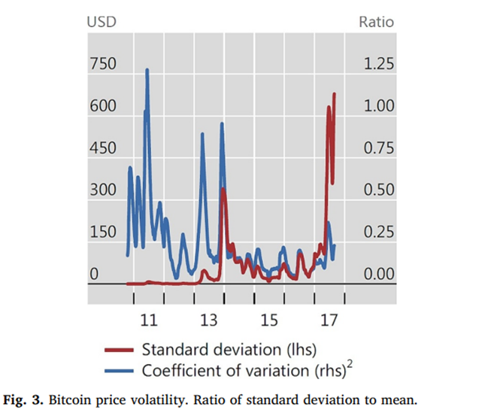
Crypto & Fiat Money
WSU
Question 3
CBDC & Concerns over Cryptocurrencies
CBDC may enhance settlement efficiency for transactions
CBDC may be the answer to the rapid disappearance of cash in some jurisdictions
Money laundering and terrorism are two issues that would need to be dealt with in a CBDC discussion
Cyber Risk and the U.S. Financial System: A Pre-Mortem Analysis
A CBDC would not fundamentally alter the mechanics of monetary policy*, but may require the bank to broaden the base of assets it can hold as collateral
Money & Payments (January 20, 2022)
The Convertibility Plan
Toni Whited et al. (2022)*

Slide 15
Smart Contracts
WSU
Question 4
“FinTech will significantly affect trading and insurance. Smart contracts are likely to substantially impact financial contracting… The provide a nice opportunity for future normative research into contracting innovations.”
The essence of smart contracts is that they enable agents who have no trust in each other to collaborate without having to go through a neutral central authority
Smart contracts may replace the need for intermediaries?
The first common instance of these smart contracts occurred in low-income countries (Thakor references BitPesa) – “TrackEuro”
“My expectation is that banks will adapt in order to be purveyors of smart contracts. They will exploit the increased contracting opportunities offered by smart contracts to modify existing contracts and create new ones.”
Quorum – JPMC → ConsenSys

Slide 16



Conclusion
WSU
This paper reviewed the ‘emerging literature’ on FinTech, focusing on the interaction between FinTech and Banking
Thakor offers two primary contributions to the literature, namely highlighting the viability of smart contracts and changes to credit analyses
This paper, while helpful, is reminiscent of the out-of-touch, reactionary mindset of so many; I fear its contribution to the literature may be minimal

